Slide 1

Welcome to Sabbath School
Illustration by Jo Card. Copyright © 2024 General Conference Corporation® of Seventh-day Adventists.

Slide 2

EARLY ARRIVALS
EARLY
ARRIVALS

Slide 3

Lord, Please Guide Me
EARLY ARRIVALS
EARLY
ARRIVALS
"Lord, Please Guide Me" by Kimberly Houliston, copyright © 2002 Abide Family Ministries. Used by permission.

Slide 4
Welcome to Sabbath School
Illustration by Jo Card. Copyright © 2024 General Conference Corporation® of Seventh-day Adventists.

Slide 5

Alive in Jesus
OPENING ACTIVITIES
Welcome to Sabbath School.
It’s good to see you.
How are you today?
Let’s have some fun
As we learn about God’s love
And follow in His way.
We’re alive in Jesus.
We’re alive in Jesus.
(Repeat above)
"Alive in Jesus" by Rosie Smith, copyright © 2024 General Conference Corporation® of Seventh-day Adventists.

Slide 6
Lord, Please Guide Me
OPENING ACTIVITIES
Lord, please guide me today.
Come and fill my life in ev’ry way.
May what I say and I do
Be reflecting Less of me
And more of You.
Lord, I need You today,
And this is what I pray.
(Repeat two times)
"Lord, Please Guide Me" by Kimberly Houliston, copyright © 2002 Abide Family Ministries. Used by permission.

Slide 7
The Lord’s Prayer
OPENING ACTIVITIES
Our Father in heaven,
Hallowed be Thy name.
Thy kingdom come,
Thy will be done on earth,
As it is in heaven.
(Continued on next slide)

Slide 8
The Lord’s Prayer
OPENING ACTIVITIES
Give us this day our daily bread,
And forgive us as we forgive,
And lead us not into temptation,
But deliver us from evil.
For Thine is the kingdom, the power, And the glory, forever and ever, Amen, amen.
(Continued on next slide)

Slide 9
The Lord’s Prayer
OPENING ACTIVITIES
Our Father in heaven,
Hallowed be Thy name.
Thy kingdom come,
Thy will be done on earth,
As it is in heaven.
(Continued on next slide)

Slide 10
The Lord’s Prayer
OPENING ACTIVITIES
Give us this day our daily bread,
And forgive us as we forgive,
And lead us not into temptation,
But deliver us from evil.
For Thine is the kingdom, the power, And the glory, forever and ever, Amen, amen.
"The Lord's Prayer" by Leanne Erickson, copyright © 2018 Leeann Erickson. Used by permission.

Slide 11
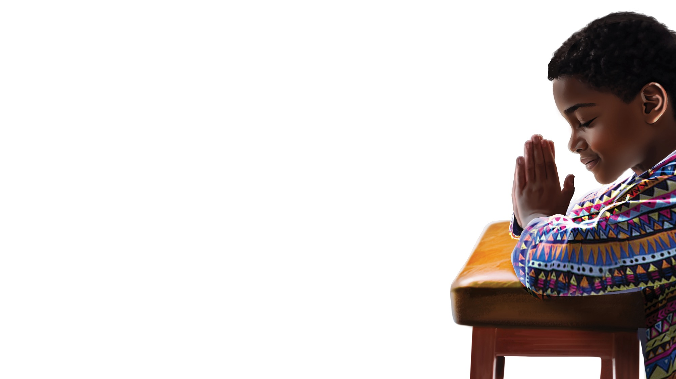
PRAYER
PRAYER

Slide 12
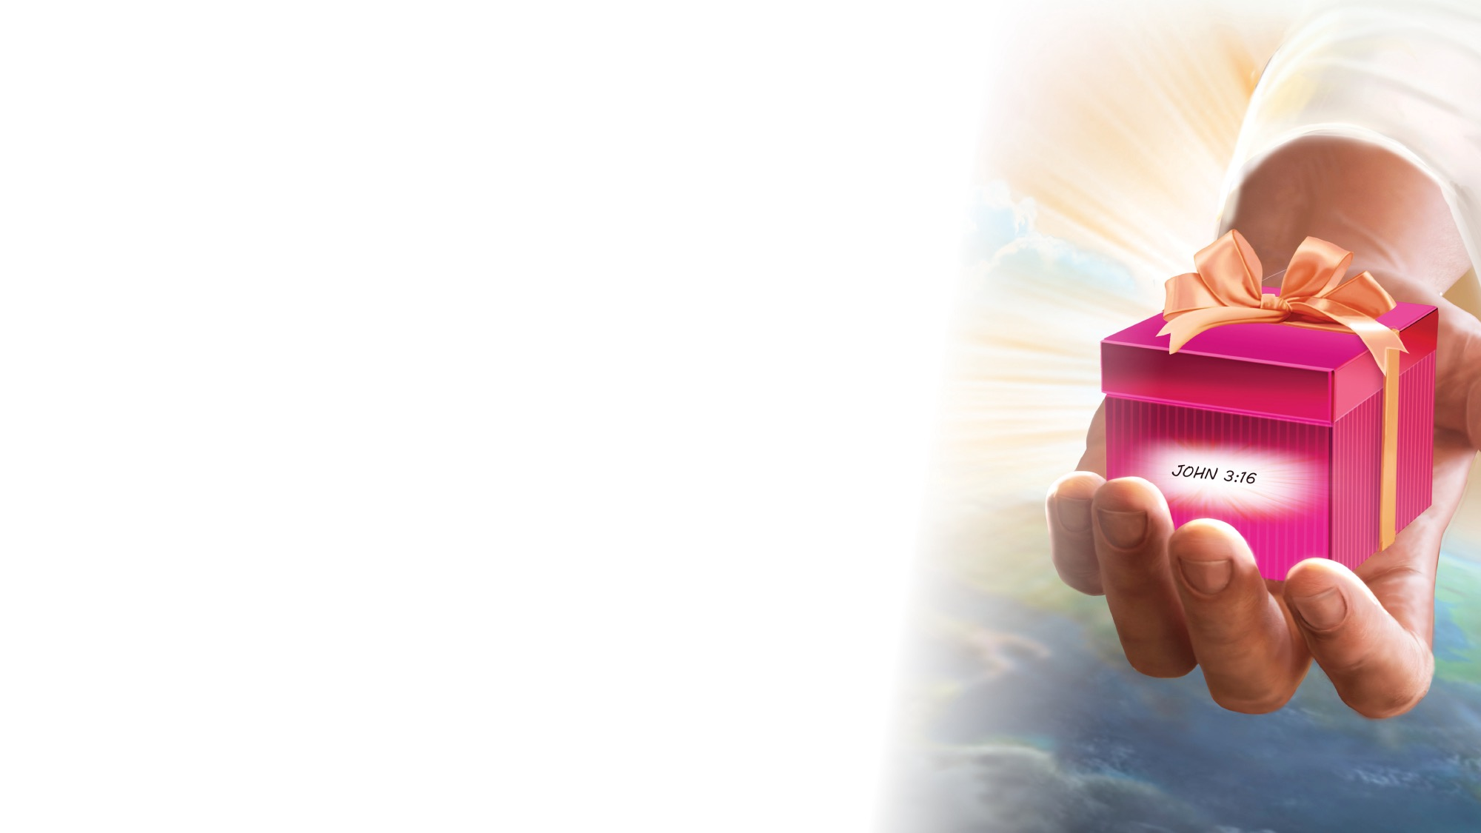
MISSION
FAST FACT &
OFFERING
CHART

Slide 13
OFFERING

Slide 14

Thank You, Jesus
OPENING ACTIVITIES
Thank you, Jesus
For providing all my needs.
I want to give a little back
Of what you’ve given me.
Please bless our
Sabbath School offering.
May it bring You glory
And help others in need.
(Repeat above)
May it bring You glory
And help others in need.
"Thank You, Jesus" by Rosie Smith, copyright © 2024 General Conference Corporation® of Seventh-day Adventists.

Slide 15
Visitor Song
OPENING ACTIVITIES
We have a new friend
With us today.
We have a new friend.
Let’s smile and wave.
We welcome you to Sabbath School.
We’re glad you came.
We welcome you,
And hope to see you again. (x2)
“Visitor Song” by Rosie Smith. Copyright © 2025 General Conference Corporation® of Seventh-day Adventists.

Slide 16
Happy Birthday
OPENING ACTIVITIES
Happy birthday, happy birthday,
Happy birthday to you.
Jesus loves you dear ___________.
Happy birthday to you.
(Repeat above)
“Happy Birthday” by Janet Sage, copyright © 2001 North American Division Corporation of Seventh-day Adventists. From Little Voices Praise Him, #39. Used by permission.

Slide 17

FOCUS
ACTIVITIES

Slide 18
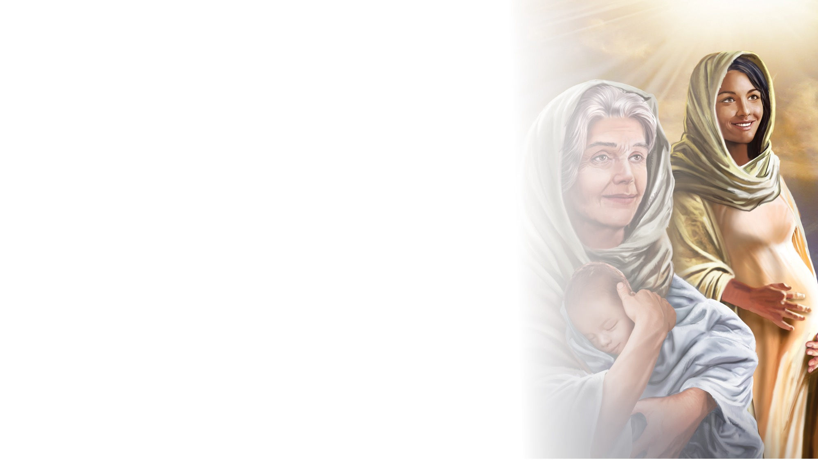
BIG IDEA
God looks for people who love Him to be part of His big story.

Slide 19

BIBLE
STORY

Slide 20


Slide 21
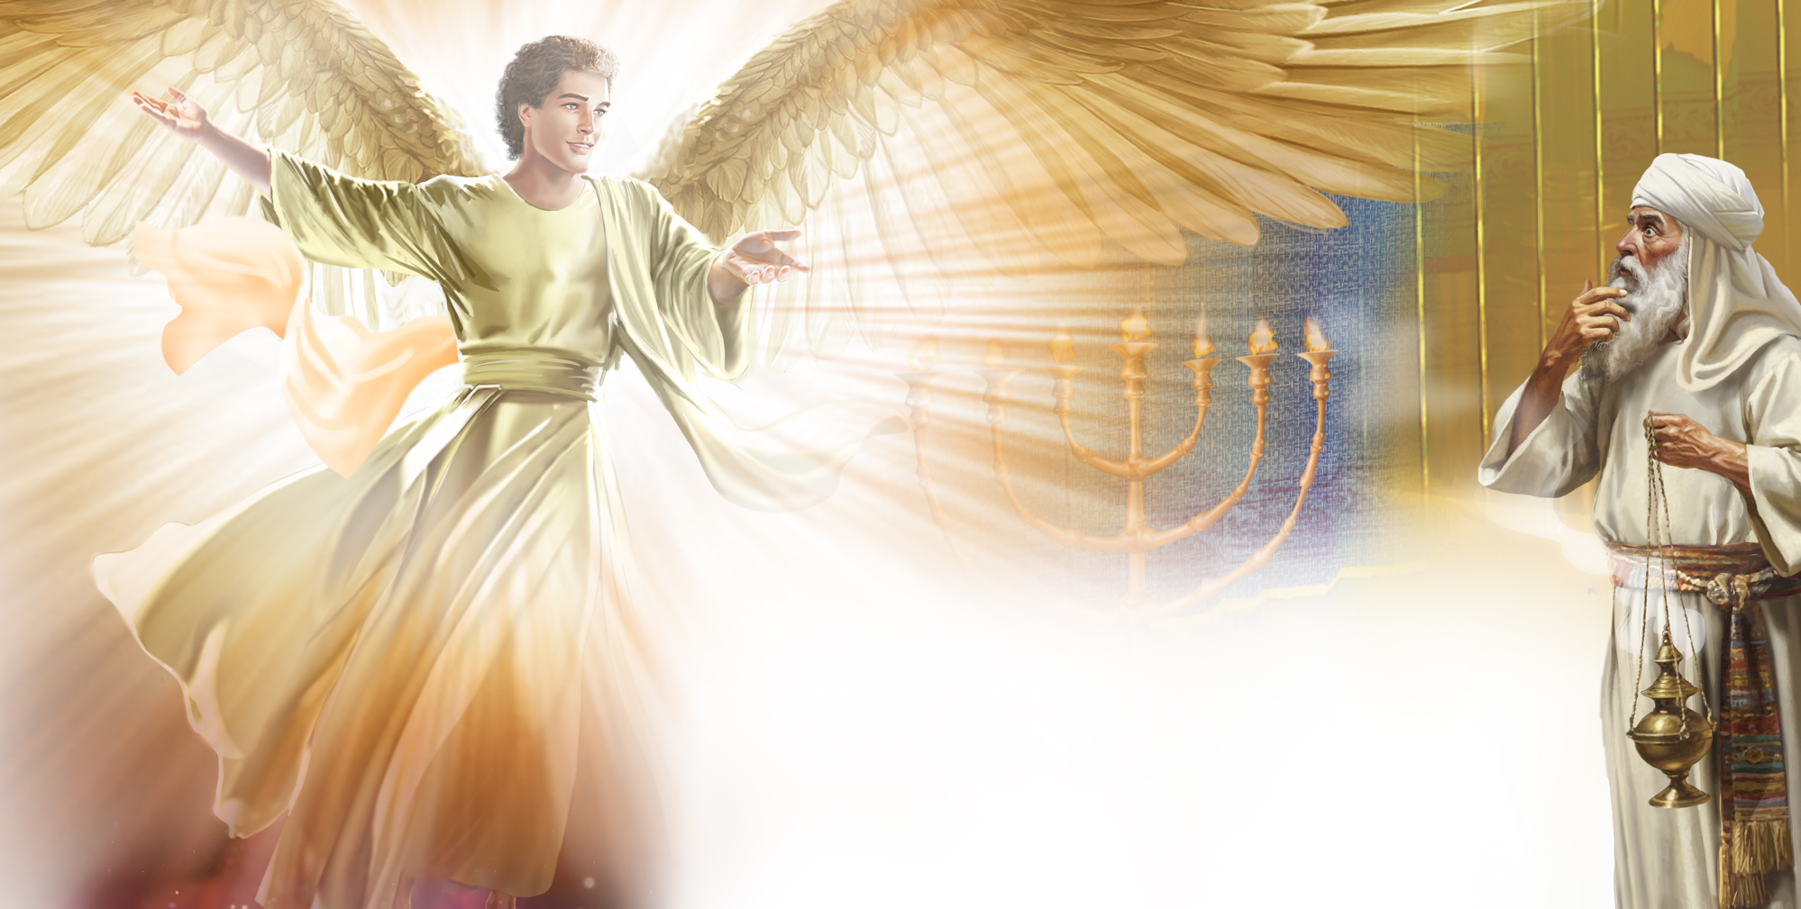
Illustration by Jo Card. Copyright © 2024 General Conference Corporation® of Seventh-day Adventists.

Slide 22
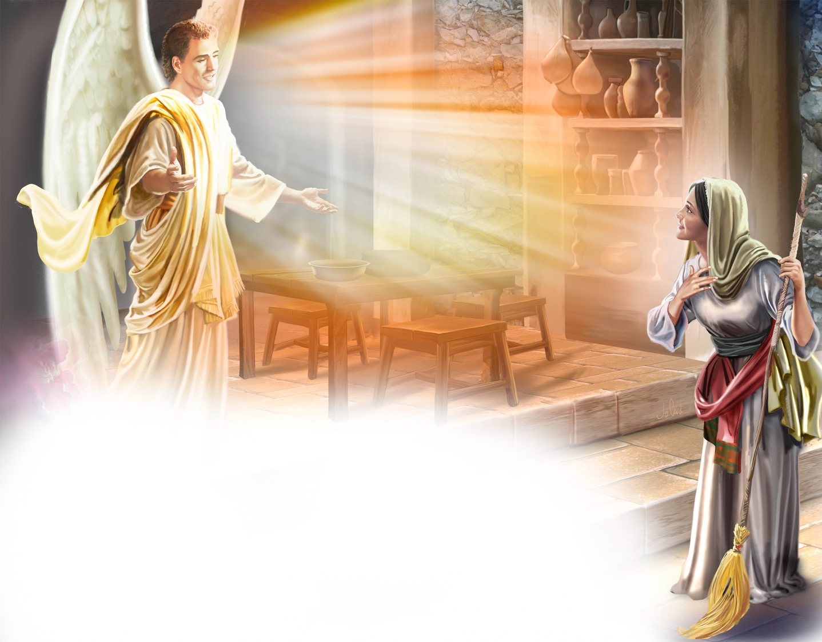
Illustration by Jo Card. Copyright © 2024 General Conference Corporation® of Seventh-day Adventists.

Slide 23
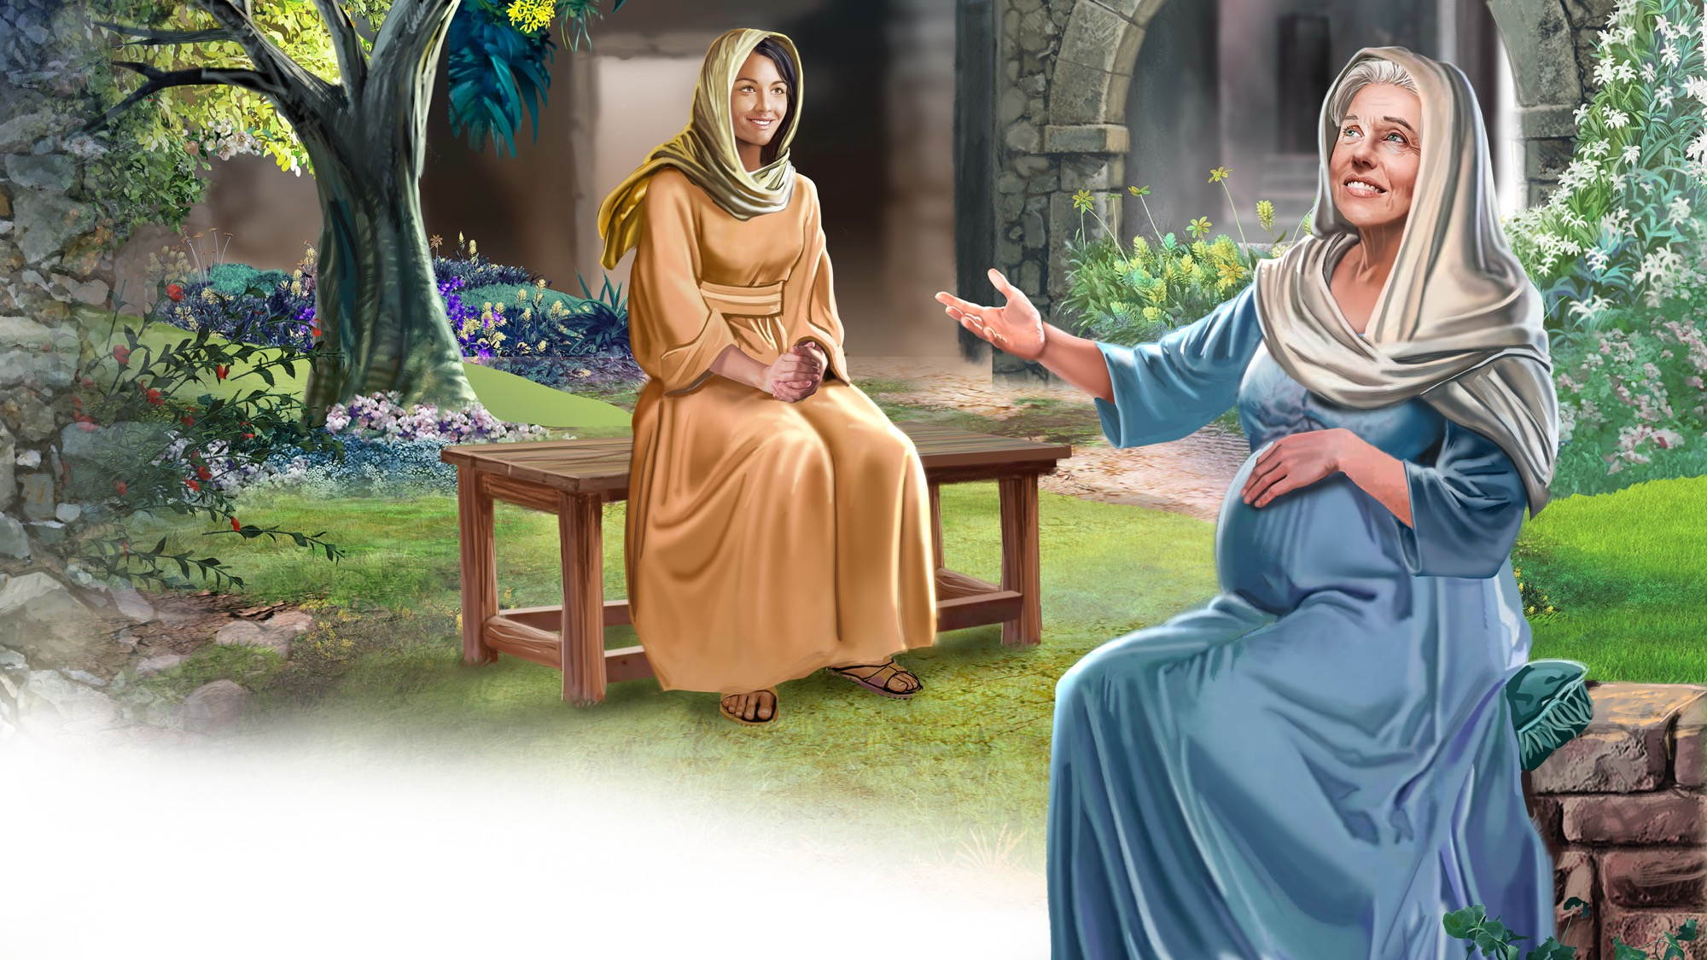
Illustration by Jo Card. Copyright © 2024 General Conference Corporation® of Seventh-day Adventists.

Slide 24
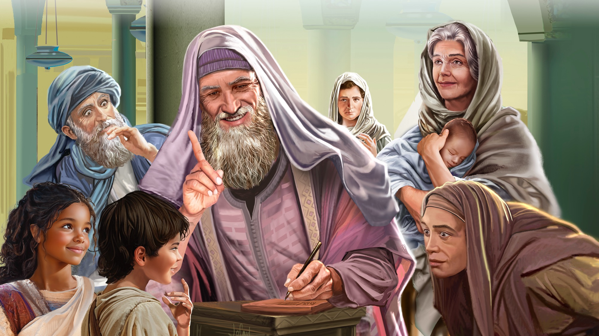
Illustration by Jo Card. Copyright © 2024 General Conference Corporation® of Seventh-day Adventists.

Slide 25
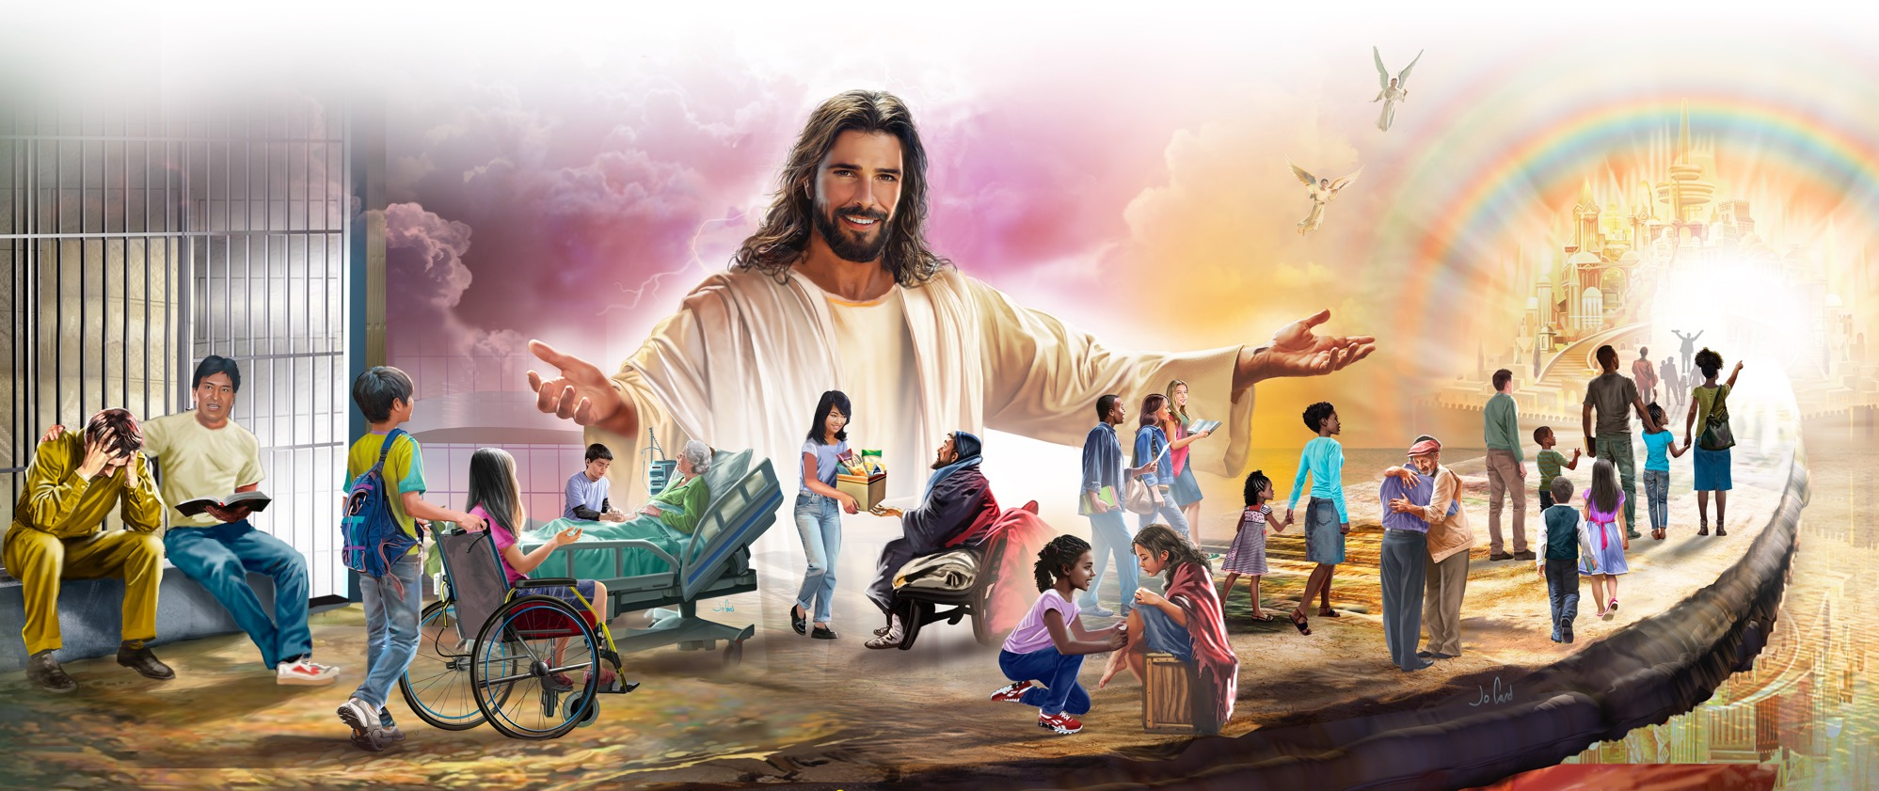
Illustration by Jo Card. Copyright © 2024 General Conference Corporation® of Seventh-day Adventists.

Slide 26
UNPACK
THE STORY

Slide 27

CHARACTER CARDS

Slide 28
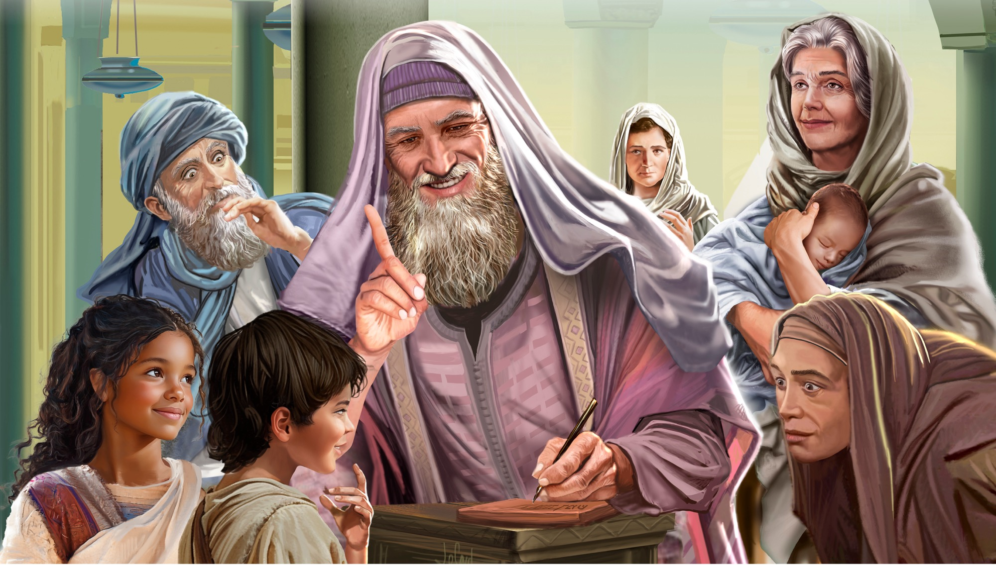
MEMORY VERSE
“For with God nothing will
be impossible.”
Luke 1:37

Slide 29
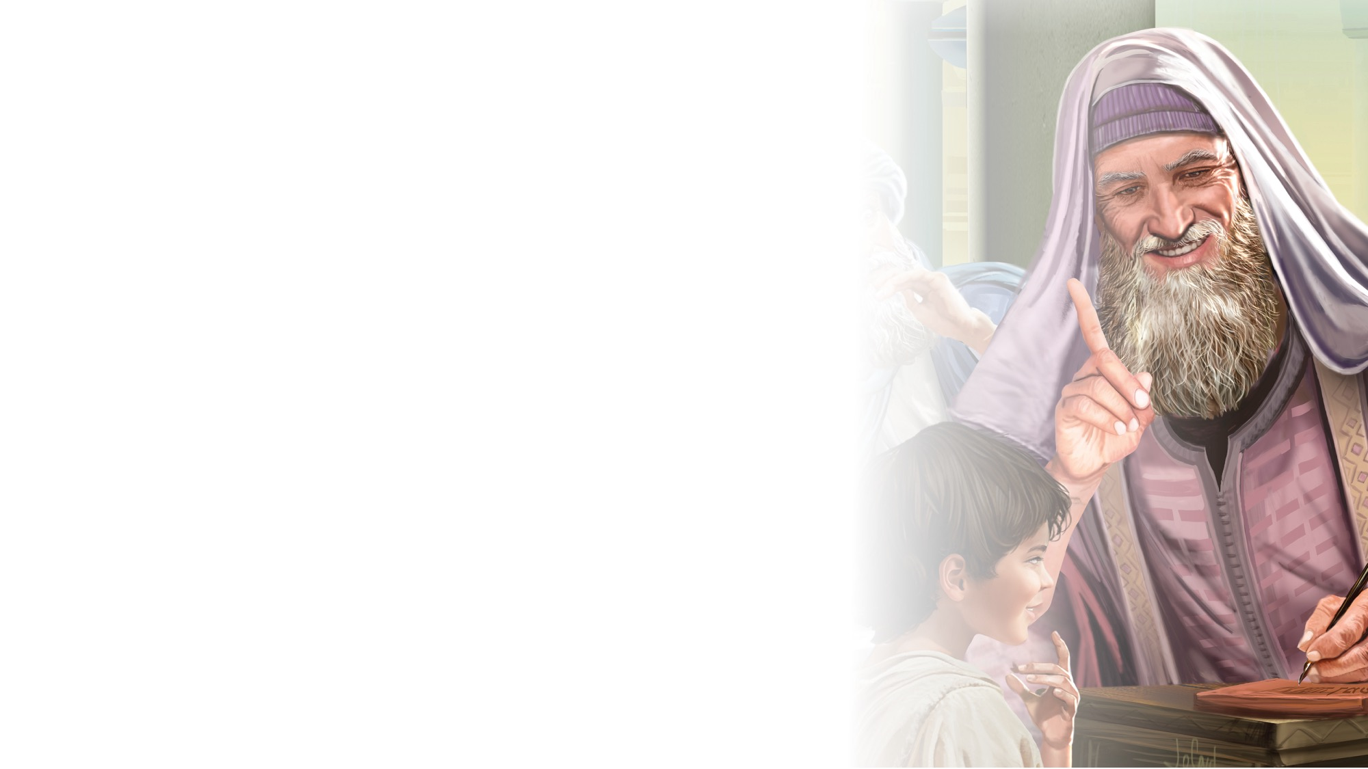
Luke 1:37
SCRIPTURE SONG
For with God, for with God, Nothing will be impossible.
Luke chapter 1, verse 37.
(Repeat two times)
"Luke 1:37" music by Rosie Smith, copyright © 2026 General Conference Corporation® of Seventh-day Adventists.

Slide 30

MISSION
STORY &
CHALLENGE

Slide 31

CRAFT

Slide 32
BIG IDEA
God looks for people who love Him to be part of His big story.

Slide 33

Lord, Please Guide Me
PRAYER
RESPOND
Lord, please guide me today.
Come and fill my life in ev’ry way.
May what I say and I do be reflecting Less of me and more of You.
Lord, I need You today,
And this is what I pray.
(Repeat two times)
"Lord, Please Guide Me" by Kimberly Houliston, copyright © 2002 Abide Family Ministries. Used by permission.

Slide 34

God Be With You
CLOSING SONG
Sabbath School is finished for the day.
Let’s say goodbye and be on our way.
Sabbath School is finished for the day.
Let’s say goodbye and be on our way.
God be with you, till we meet again.
God be with you, my dear friends.
God be with you, till we meet again.
God be with you, my dear friends.
"God Be With You" by Rosie Smith, copyright © 2025 General Conference Corporation® of Seventh-day Adventists.

Slide 35
PRAYER
PRAYER

